Slide 1
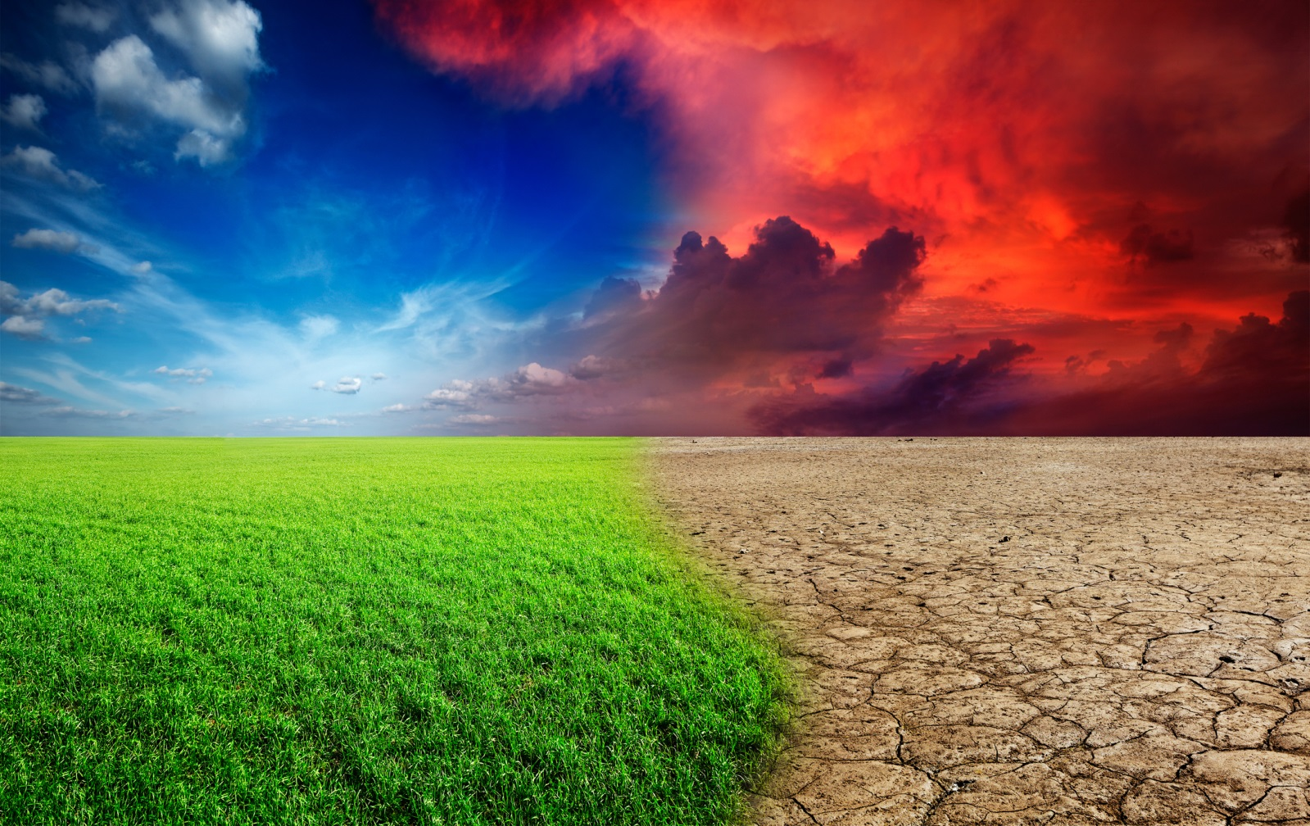
Climate Change Training

Slide 2
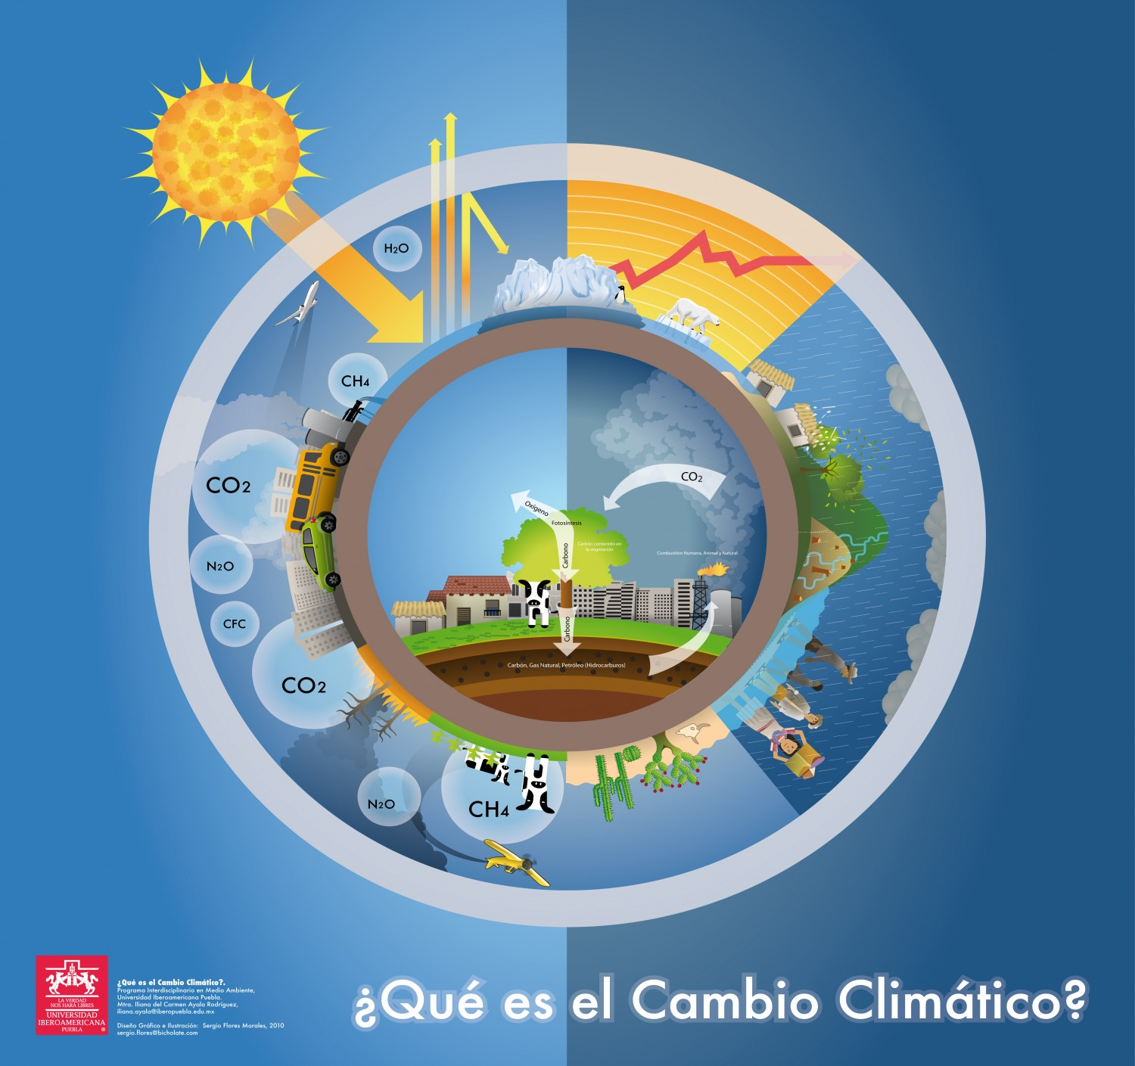
What is climate change?
Notes:
Climate change, also known as global warming, refers to the changes to weather patterns over time –or the climate- which is what is happening with the earth’s increase in temperature.

Slide 3
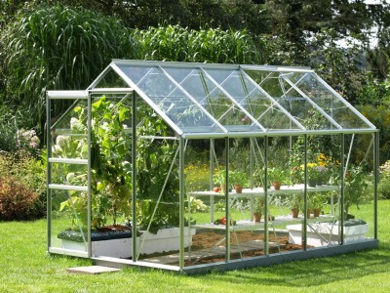
Image source: tn173.com
Notes:
The planet’s temperature or climate depends on the balance between the heat that enters the earth from the sun during the day and the heat that leaves the earth when it cools off during the night.
The effect by which the earth maintains a temperature that is not too hot or too cold is known as greenhouse effect.
This effect is produced by the natural vapors and gases like carbon dioxide, methane, and ozone that make up the earth’s atmosphere.
The intensity of the sun’s rays, the ability of the earth to reflect back the heat or to cool off, or the increase in any of the gases in the atmosphere can all change the planet’s temperature.
Changes in climate have occurred before in the earth’s history, but it wasn’t until the last 200 years (or since the industrial era) that we have been burning large amounts of fossil fuels (oil, coal, natural gas) on a level that drastically increased carbon dioxide in the atmosphere, so that is higher than it has been in at least 800,000 years. When this happens, the heat that enters the earth does not leave the earth in equal proportions and the earth remains heated. This additional heat that is not reflected back to space is increasing the overall average temperature of the earth, though it still goes up and down on a daily basis.

Slide 4
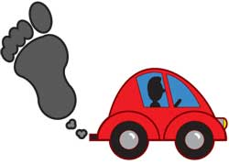
The carbon footprint
Notes:
We call our contribution to greenhouse emissions “carbon footprint.” Some examples of our personal contribution to the carbon footprint include driving, using electricity and disposing of waste.

Slide 5
Notes:
Climate change causes the temperature to increase so we are more likely to have hotter or more extreme heat more often.

Slide 6
Notes:
When temperatures increase, it dries the soil faster and we can have droughts. Droughts can reduce agricultural production which can raise food prices.

Slide 7
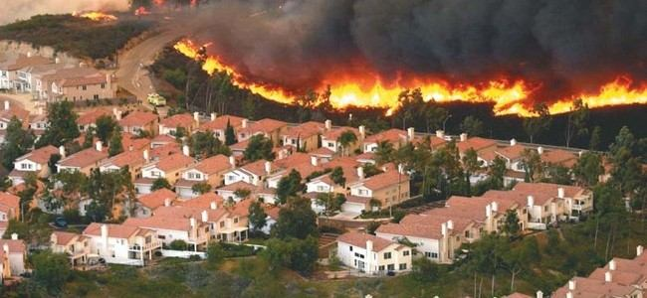
Notes:
Heat also causes forests to dry out and be subject to more frequent and intense wildfires.

Slide 8
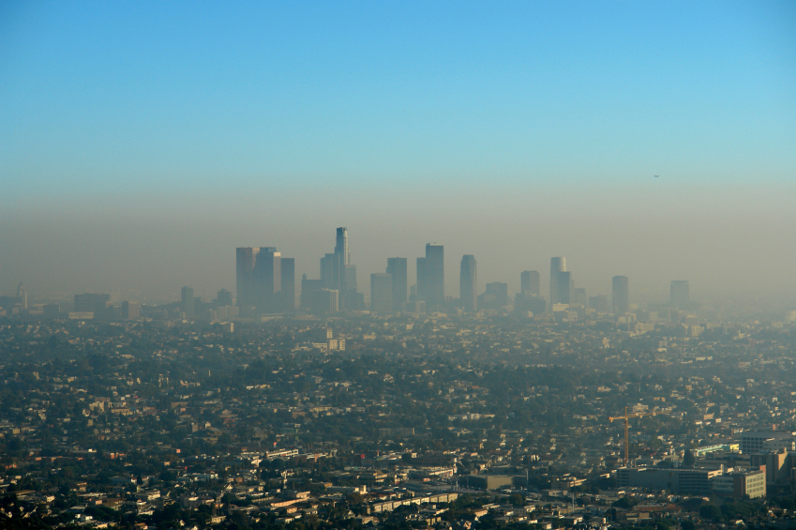
Notes:
Wildfires cause small particles of burned materials to go into the air, increasing pollution in cities and rural areas.
Also, more heat makes pollution from automobiles and other sources worse, by creating more ozone, which is unhealthy to breathe.

Slide 9
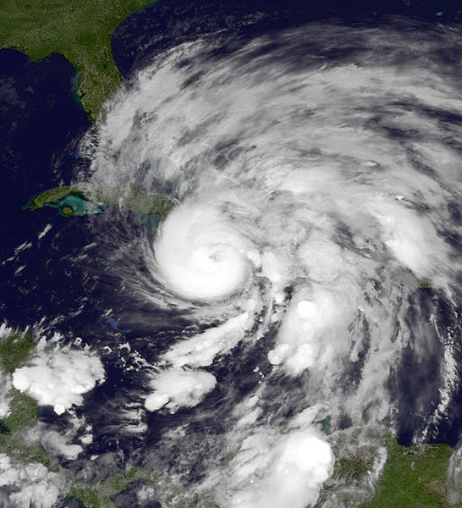
Notes:
The heat has also made the ocean warmer and when this happens, extreme storms carry more water and strong winds that can cause storm surge on the coast and inland flooding.

Slide 10
Notes:
Severe weather, extreme rainfall, floods, and other water issues, can displace populations, cause death from drowning, injuries, damage to drinking water, waste water, and irrigation systems which can decrease the quantity and quality of the water supply and can affect agriculture.

Slide 11
Notes:
Climate change can also increase the number and range of vector-borne diseases, such as West Nile virus and malaria; water-borne diseases such as cholera and E.coli; food-borne diseases such as salmonella poisoning; harmful algae blooms; and allergies.

Slide 12
How does climate change affect health?

Slide 13
Extreme heat

Slide 14
Heat stroke
Cardiovascular problems
Kidney stones
Breathing difficulty
Injuries
Death
Notes:
Who is most affected or vulnerable to extreme heat?
The elderly
Babies
Diabetics
Low income people
People with respiratory diseases or other chronic conditions
Agricultural workers or those that work outside
People who spend time outdoors including athletes
Homeless people
People of color

Slide 15
Drought

Slide 16
Hunger
Malnutrition
Food and water-borne diseases
Emergence of new contagious and vector-borne diseases
Notes:
Who is most affected or vulnerable to droughts?
The elderly
Babies
Low income people

Slide 17
Wildfires

Slide 18
Injuries and death from burns
Respiratory, lung, and cardiovascular diseases
Increase in asthma and allergies
Breathing problems
Notes:
Who is most affected or vulnerable to wildfires?
People with respiratory conditions
Firemen or rescue workers
People with disabilities or chronic conditions that make it harder to evacuate safely.
Elderly
Babies
Pregnant women

Slide 19
Air Pollution

Slide 20
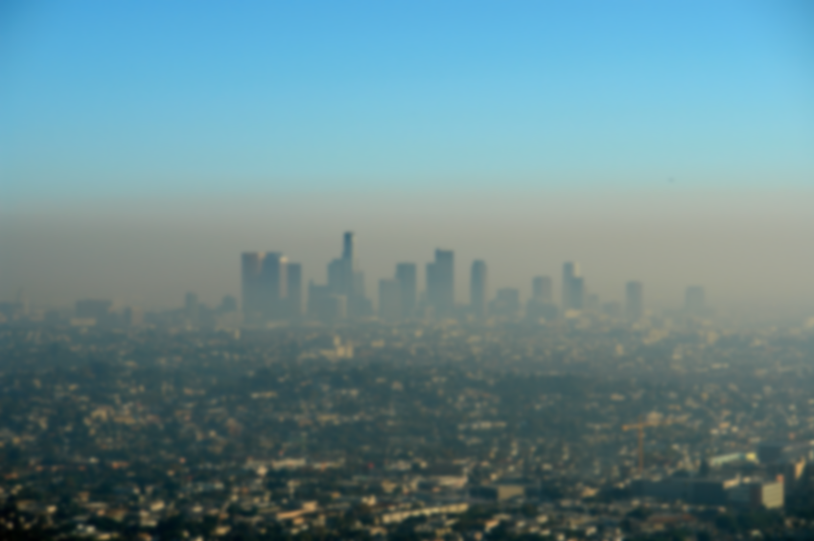
Respiratory, lung, and cardiovascular diseases
Increase in asthma and allergies
Breathing difficulty
Notes:
Who is most affected or vulnerable to air pollution?
The elderly
Babies and infants
Low income people
People with respiratory diseases or other chronic conditions
Agricultural workers or those that work outside
People who spend time outdoors, including athletes
Homeless people

Slide 21
Extreme weather events

Slide 22
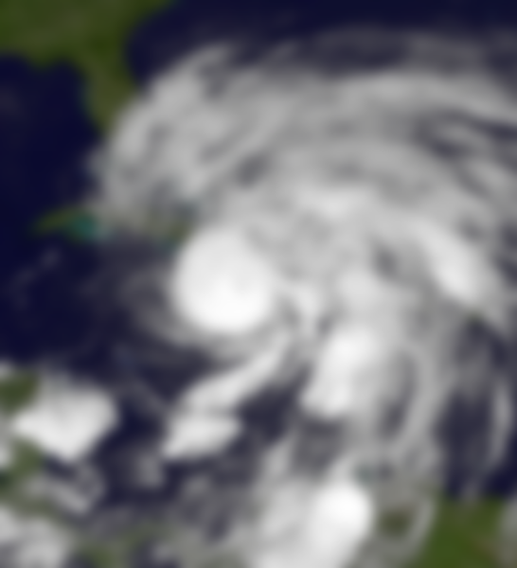
Population displacement
Loss of homes, lives, and livelihood
Death from drowning
Injuries
Damage to drinking water, waste water, and irrigation systems
Increase of infectious diseases
Notes:
Who is most affected or vulnerable to extreme weather events?
People who live by the coast or areas susceptible to floodings
Elderly people
Children
Low income people
Homeless people
People with dissabilities

Slide 23
What can I do?
What will happen?
Do we still have time to do something ?
Who can help us?
Notes:
Have participants watch the videos “How to reduce the impact of climate change” and “How can we adapt to the impacts of climate change.”

Slide 24
Questions?

Slide 25
Thanks!

